Slide 1
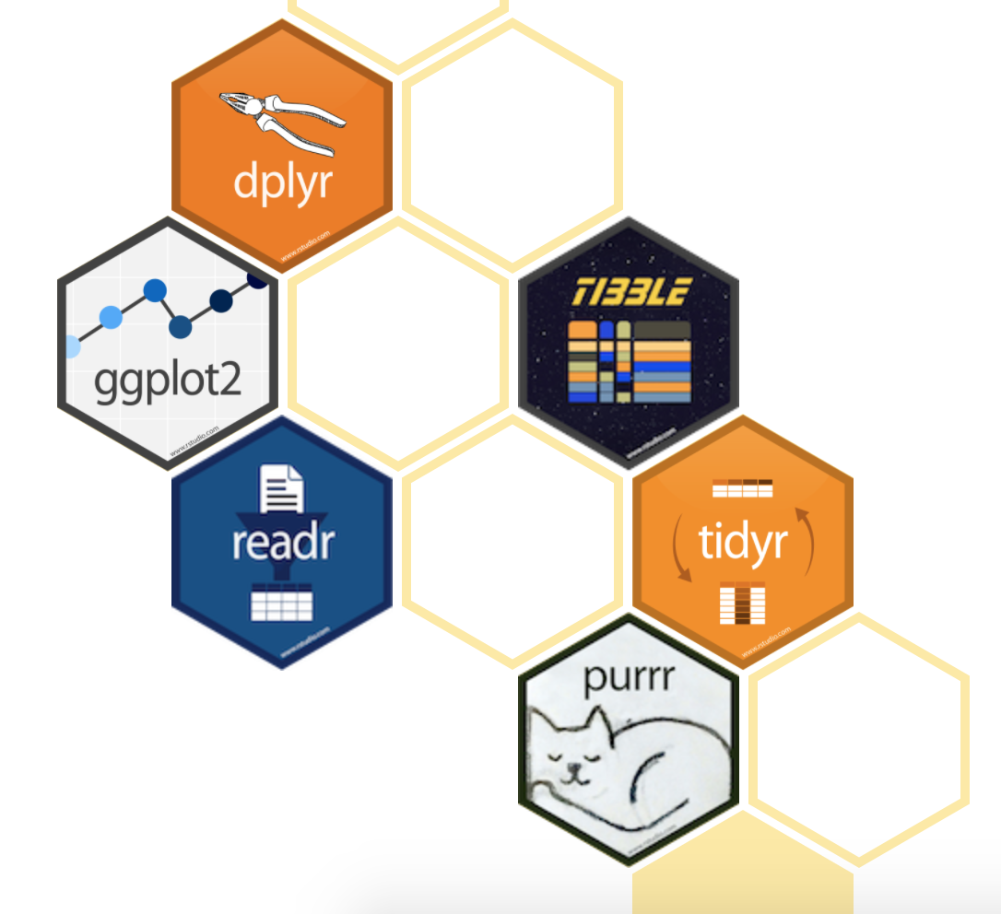
N BROWN
R User Group #3
The Grammar of Graphics:

Slide 2

Overview
The tidyverse is a set of packages that work in harmony because they share common data representations and API design. The tidyverse package is designed to make it easy to install and load core packages from the tidyverse in a single command.

Slide 3
ggplot2
The ggplot2 package is an extremely powerful data visualisation tool based on the ideas of a ”Grammar of Graphics”. Whilst there are a number of very long and indepth explanations of this (see Leland Wilkinson’s book ”The Grammar of Graphics”) it can be summarised as this:
Take one of these:
And imagine that you’re building up some data representation in layers, as you would by adding an acetate at a time to and overhead projector:
First you take some data
Then build your graph in parts
Bit
By Bit

Slide 4
ggplot2
That’s pretty cool, Chris.
I think the best way to show this is by doing.
Why don’t you fire up R Studio (in a project no less) and demonstrate?
GOALS

Slide 5
ggplot2
A few last things:
It’s best to learn it by using the tool, it is a very different way of approaching your data plots however once you’re head clicks it works really well. Try and use ggplot where you would normally go to excel. It’s much more powerful
There is no shame in using the ggplot2 cheatsheet. There’s so much in ggplot2 that it’s very very easy to get lost. There’s a copy in the github folder for this session.
And finally a competition. Whoever is the first to send me some R code that can accurately reproduce the Economist chart to the left will win a prize.

